Slide 1

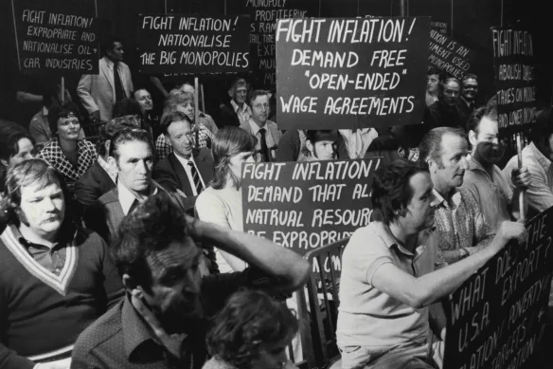
Are we heading for 1970’s-esque inflation?
USYD Fintech Bootcamp - Group 1
Malcolm Miller
Ogaga Edafe
Celine Zhao
Tom Mortlock-Chapman

Slide 2
Executive Summary
Hypothesis:
If current economic conditions are similar to the 1960-70’s, can we expect similar rampant inflation to the 1970’s?
Critical Questions (Agenda):
What was the economic climate in the decade preceding the 1970’s and how does this compare to the last decade?
Is the stock market a lead indicator for inflation?
Is government spending correlated to inflation?
Is a rise in gold prices a lead indicator for inflation?
Abstract (Outcomes):
As is with many economic debates, there are most certainly characteristics that replicate the 1970’s and lead us to believe we may well be heading for similar inflationary periods, however there are also limitations and opposing outcomes from the data we have analyzed therefore begging the question “will it be that bad?”.

Slide 3
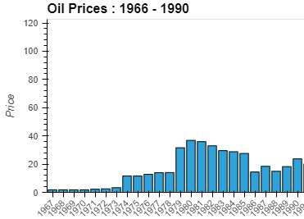
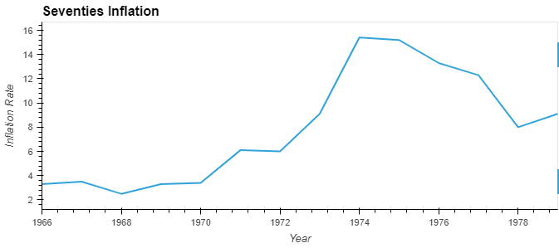
What did the 1970’s look like?
The economic crisis and recession of the mid-70’s was headlined by:
OPEC oil embargo in retaliation to countries supporting Israel in the Israeli-Arab War pumping the price of oil up nearly 300%.
Govt. spending significantly rising to 18% of GDP
Stock market crashing in ’74 (-26.47%)
Wage prices rising
Overall persistent, spiraling inflation to peaks of 20%
DATA TECHNIQUES
pd.read_csv (to grab oil price data)
pd.read_html (to grab inflation data)
hvplot.bar and hvplot.line (to visualize both data sets

Slide 4
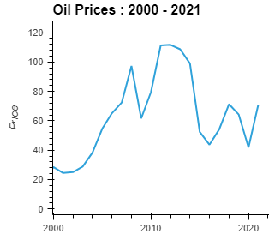
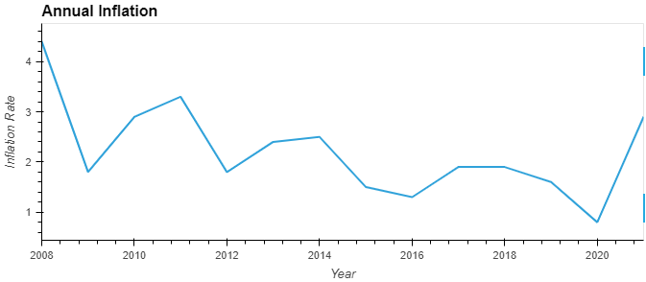
And what are we seeing now?
Significant recent rises in inflation under the guise of similar economic characteristics to the 60/70’s including:
EU embargos on Russian oil due to the conflict in Ukraine
Government spending risen to 21% of GDP
Wage price rising similarly
Stock market crashing by 9.34% in 2022
Inflation rising to 8%
DATA TECHNIQUES
pd.read_csv (to grab oil price data)
pd.read_html (to grab inflation data)
hvplot.bar and hvplot.line (to visualize both data sets
df.loc, .rename, .reset_index (to manipulate data into timeframes)

Slide 5
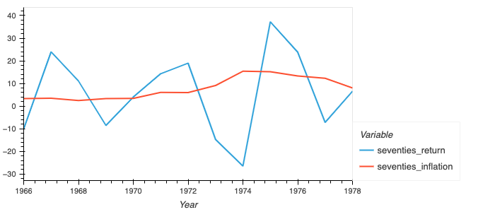
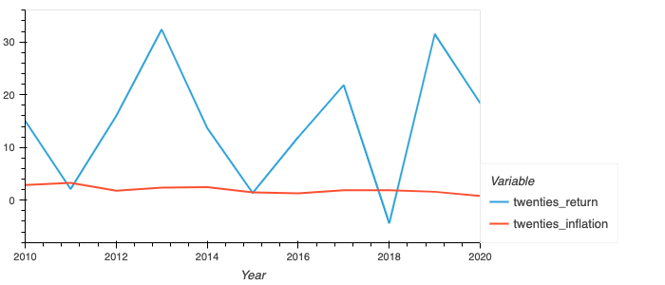
Is the stock market a lead indicator for inflation?
The stock market is not the most important indicator. However, it is one of the most well-known and widely followed.
Comparing the 70’s to the 20’s – the changes in inflation correlates slightly with the stock market. In more recent times there have been a bit more consistency with the rate of inflation, which makes it easier to spot a macroeconomic issue that may have varying impacts on stocks which could in turn increase market volatility. This still does not serve as an outright indicator. However, historically and even as seen on the seventies chart, higher inflation has correlated with lower stock market returns
DATA TECHNIQUES
read_csv - S&P 500 data, sourced csv through webpage and used the format to pull.
Hvplot.line for data visualisation

Slide 6
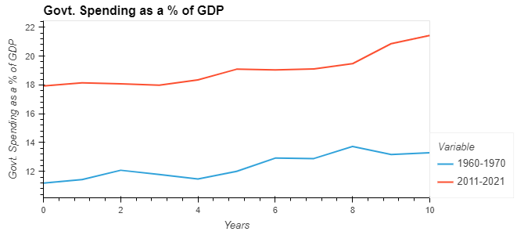
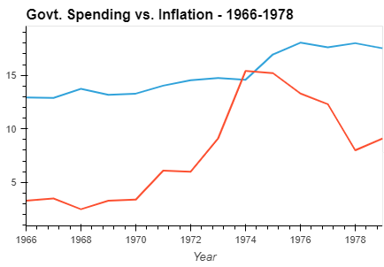

How correlated is Govt. spending to inflation?
Govt. spending as a factor in aggregate demand has been argued as a driver of inflation. The following results were found:
Govt. spending between the 70’s and now proved highly correlated (0.77)
In the 70’s govt. spending was highly correlated with inflation aswell (0.71)
However, when correlating inflation and Govt. S. in last decade it marginally negatively correlated.
DATA TECHNIQUES
pd.read_csv (to grab oil price data)
pd.concat (to concatenate and compare inflation with gs.)
hvplot.line (to visualize both data sets
.iloc, .rename, .reset_index (to manipulate data into timeframes)
.corr (for correlation analysis)

Slide 7
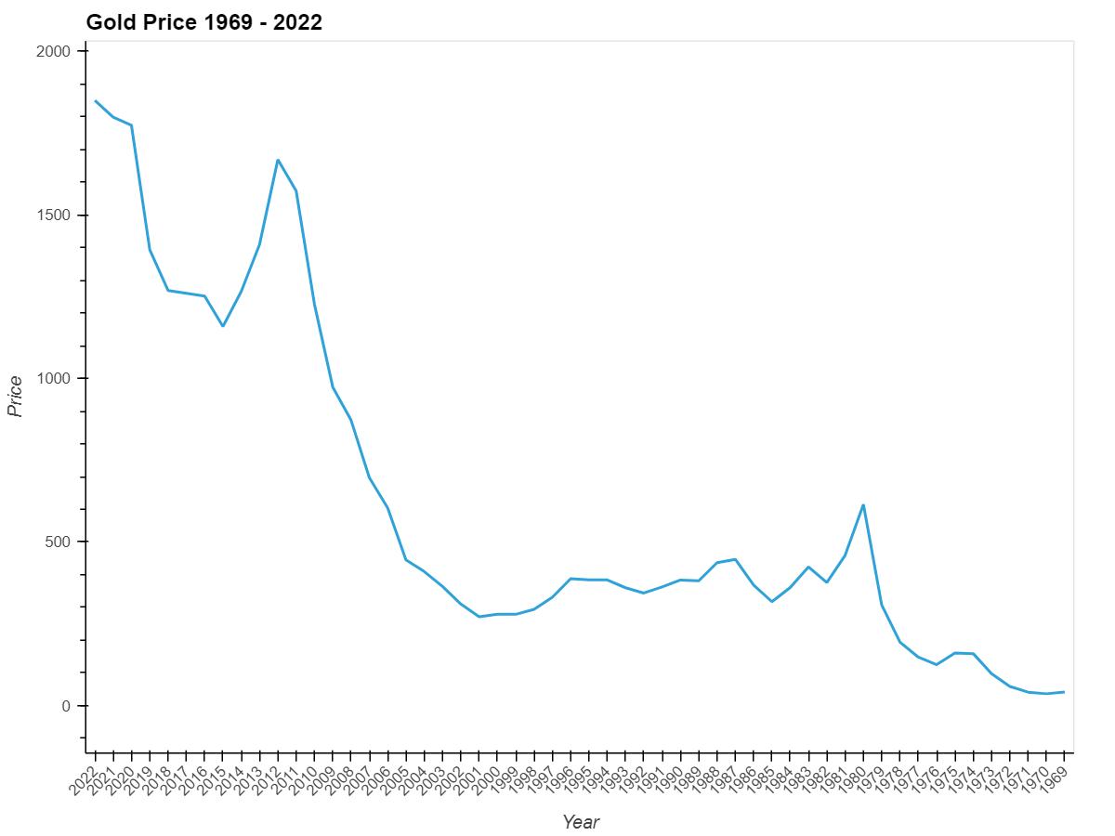
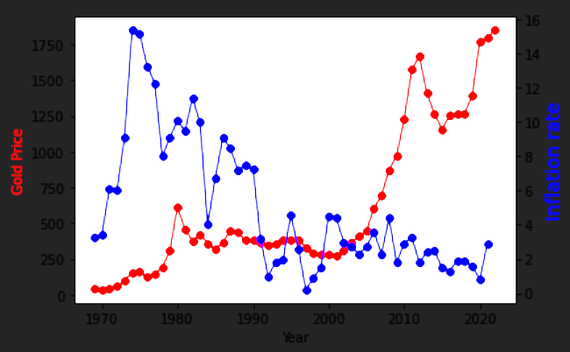
Are rising gold prices a lead indicator of inflation?
Gold has served to protect wealth through periods of higher inflation, most notably throughout the 1970s
Triggered by a surge in crude oil prices and inflation after the Iranian revolution, the oil price surged in the 1979-80.
However, it seems that after that period, gold prices are not correlated specifically to inflation rate anymore.
DATA TECHNIQUES:
BeautifulSoup - Website Data Scraping
Matplot library

Slide 8
Conclusion – Could add some graphic to break this up
Results - Critical Questions:
Whilst there are most certainly similarities in amongst various economic indicators, there are certainly differences such as no official cash rate target in the 70’s
Stock market proved to be rather volatile indicator not accurately correlated to inflation, particularly in current period
Government spending whilst reflecting strong correlation to the 70’s and inflation at the time, the current inflationary environment is not yet correlating with substantial recent govt. spending.
Gold did not provide sufficient evidence for correlation despite literature suggesting so.
Limitations
Infinite economic metrics to consider, bond prices, commodities; alongside further time limitations for deeper and stronger relationship analysis
If there was a definitive metric to approach and then you would hope our govt would have found it by now
Data sourcing limitations with different time periods available
Is there an answer?…

